Slide 1
Software Requirements Engineering
Requirements Prioritization and Validation
Notes:
‹#›

Slide 2
Requirements Prioritization
Why prioritize requirements?
Every project with resource limitations needs to define the relative priorities of the requested product capabilities.
Prioritization, also called requirements triage helps reveal competing goals, resolve conflicts, plan for staged or incremental deliveries, control scope creep,and make the necessary trade-off decisions.
If customers don’t distinguish their requirements by importance and urgency, project managers must make these decisions on their own.
Not surprisingly, customers might not agree with a project manager’s priorities; therefore, customers must indicate which requirements are needed initially and which can wait

Slide 3
Some prioritization pragmatics
It’s difficult enough to get any one customer to decide which of his requirements are top priority.
Achieving consensus among multiple customers with diverse expectations is even harder.
Things to consider for prioritizing requirements
The needs of the customers
The relative importance of requirements to the customers
The timing at which capabilities need to be delivered
Requirements that serve as predecessors for other requirements and other relationships among requirements
Which requirements must be implemented as a group
The cost to satisfy each requirement

Slide 4
Some prioritization pragmatics
Customers place a high priority on those functions that provide the greatest business or ­usability benefit.
However, after a developer points out the cost, difficulty, technical risk, or trade-offs associated with a specific requirement, the customers might conclude that it isn’t as essential as they first thought.
The developer might also decide to implement certain lower-priority functions early on because of their effect on the system’s architecture, laying the foundation to implement future ­functionality efficiently without major restructuring.

Slide 5
Some prioritization techniques
1. In or out
The simplest of all prioritization methods is to have a group of stakeholders work down a list of requirements and make a binary decision: is it in, or is it out?
Keep referring to the project’s ­business objectives to make this judgment, paring the list down to the bare minimum needed for the first release.
Then, when implementation of that release is under way, you can go back to the previously “out” requirements and go through the process again for the next release.

Slide 6
Some prioritization techniques
2. Pairwise comparison and rank ordering
People sometimes try to assign a unique priority sequence number to each requirement.
Rank ordering a list of requirements involves making pairwise comparisons between all of them so you can judge which member of each pair has higher priority.

Slide 7
Some prioritization techniques
Three-level scale
A common prioritization approach groups requirements into three categories high, medium, and low priority.
To make the scale useful, the stakeholders must agree on what each level means in the scale they use.
One way to assess priority is to consider the two dimensions of importance and urgency.
High-priority requirements are both important (customers need the capability) and urgent (customers need it in the next release).
Medium-priority requirements are important (customers need the capability) but not urgent (they can wait for a later release).
Low-priority requirements are neither important (customers can live without the capability if necessary) nor urgent (customers can wait, perhaps forever).

Slide 8
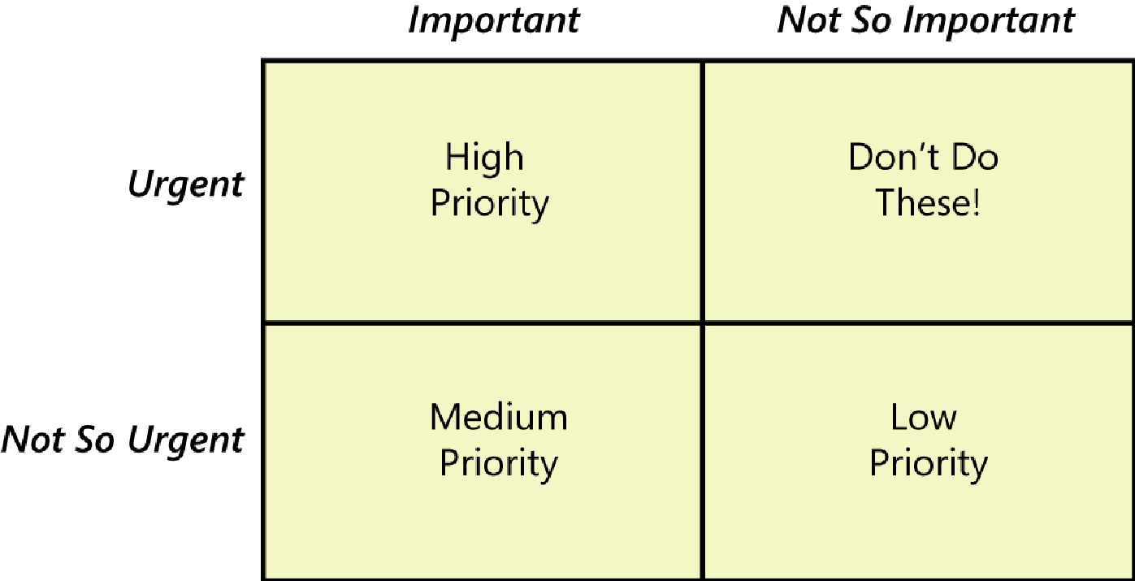

Slide 9
Some prioritization techniques
MoSCoW
The four capitalized letters in the MoSCoW prioritization scheme stand for four possible priority classifications for the requirements in a set (IIBA 2009):
Must: The requirement must be satisfied for the solution to be considered a success.
Should: The requirement is important and should be included in the solution if possible, but it’s not mandatory to success.
Could: It’s a desirable capability, but one that could be deferred or eliminated. Implement it only if time and resources permit.
Won’t: This indicates a requirement that will not be implemented at this time but could be included in a future release.

Slide 10
Some prioritization techniques
$100
One way to make prioritization more tangible is to cast it in terms of an actual resource: money.
Give the prioritization team 100 imaginary dollars to work with.
Team members allocate these dollars to “buy” items that they would like to have implemented from the complete set of candidate requirements.
They weight the higher-priority requirements more heavily by allocating more dollars to them.
When they are out of money, nothing else can be implemented, at least not in the release they are currently focusing on.
One approach is to have different participants in the prioritization process perform their own dollar allocations, then add up the total number of dollars assigned to each requirement to see which ones collectively come out as having the highest priority.

Slide 11
Requirements Validation
Most software developers have experienced the frustration of being presented with requirements that were ambiguous or incomplete
It costs far more to correct a requirement error after implementation than to correct one found during requirements development.
One study found that it took an average of 30 minutes to fix a defect discovered during the requirements phase. In contrast, 5 to 17 hours were needed to correct a defect identified during system testing.
Clearly, any measures you can take to detect errors in the requirements specifications will save time and money

Slide 12
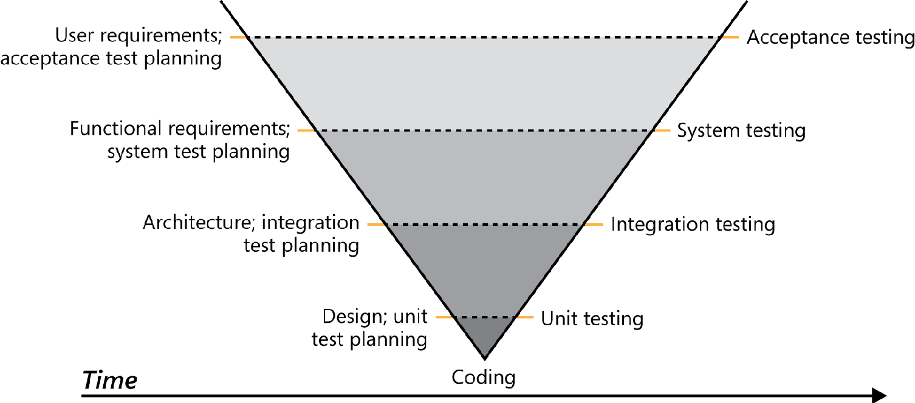

Slide 13
The figure shown previously is the V model of software development.
It shows test activities beginning in parallel with the corresponding development activities.
This model indicates that acceptance tests are derived from the user requirements, system tests are based on the functional requirements, and integration tests are based on the system’s architecture.

Slide 14
Verification and Validation
Requirements validation is the fourth component of requirements development, along with elicitation, analysis, and specification.
Precisely speaking, validation and verification are two different activities in software development. Verification determines whether the product of some development activity meets its requirements (doing the thing right). Validation assesses whether a product satisfies customer needs (doing the right thing).
Extending these definitions to requirements, verification determines whether you have written the requirements right: your requirements have the desirable properties.
Validation of requirements assesses whether you have written the right requirements: they trace back to business objectives.

Slide 15
Requirements Validation
Requirements validation activities attempt to ensure that:
The software requirements accurately describe the intended system capabilities and properties that will satisfy the various stakeholders’ needs.
The software requirements are correctly derived from the business requirements, system requirements, business rules, and other sources.
The requirements are complete, feasible, and verifiable.
All requirements are necessary, and the entire set is sufficient to meet the business objectives.
All requirements representations are consistent with each other.
The requirements provide an adequate basis to proceed with design and construction.

Slide 16
1. Reviewing requirements
Anytime someone other than the author of a work product examines the product for problems, a peer review is taking place.
Reviewing requirements is a powerful technique for identifying ambiguous or unverifiable requirements, requirements that aren’t defined clearly enough for design to begin, and other problems.
Different kinds of peer reviews go by a variety of names. Informal reviews are useful for educating other people about the product and collecting unstructured feedback.
However, they are not systematic, thorough, or performed in a consistent way. Informal review approaches include:
A peer deskcheck, in which you ask one colleague to look over your work product.
A passaround, in which you invite several colleagues to examine a deliverable concurrently.
A walkthrough, during which the author describes a deliverable and solicits comments on it

Slide 17
2. The inspection process
Any software work product can be inspected, including requirements, design documents, source code, test documentation, and project plans.
Participants:
Author
Sources of information
People doing work based on item being inspected
People responsible for interfacing systems affected by the item being inspected

Slide 18
3. Checklists
To help reviewers look for typical kinds of errors in the products they review, develop a defect checklist for each type of requirements document your projects create.
Checklists serve as reminders.
Completeness
Correctness
Quality attributes
Traceability
Other issues

Slide 19
4. Prototyping requirements
It’s hard to visualize how a system will function under specific circumstances just by reading the requirements.
Prototypes are validation tools that make the requirements

Slide 20
5. Tests
Tests that are based on the functional requirements or derived from user requirements help make the expected system behaviors tangible to the project participants.
The simple act of designing tests will reveal many problems with the requirements long before you can execute those tests on running software.
Writing functional tests crystallizes your vision of how the system should behave under certain conditions

Slide 21
Tests for Use case “View a Stored User Order”
User enters order number to view, the order exists, user had placed the order. Expected result: show order details.
User enters order number to view, the order doesn’t exist. Expected result: Display message “Sorry, I can’t find that order.”
User enters order number to view, order exists, user hadn’t placed the order. Expe: “Sorry, that’s not your order”

Slide 22
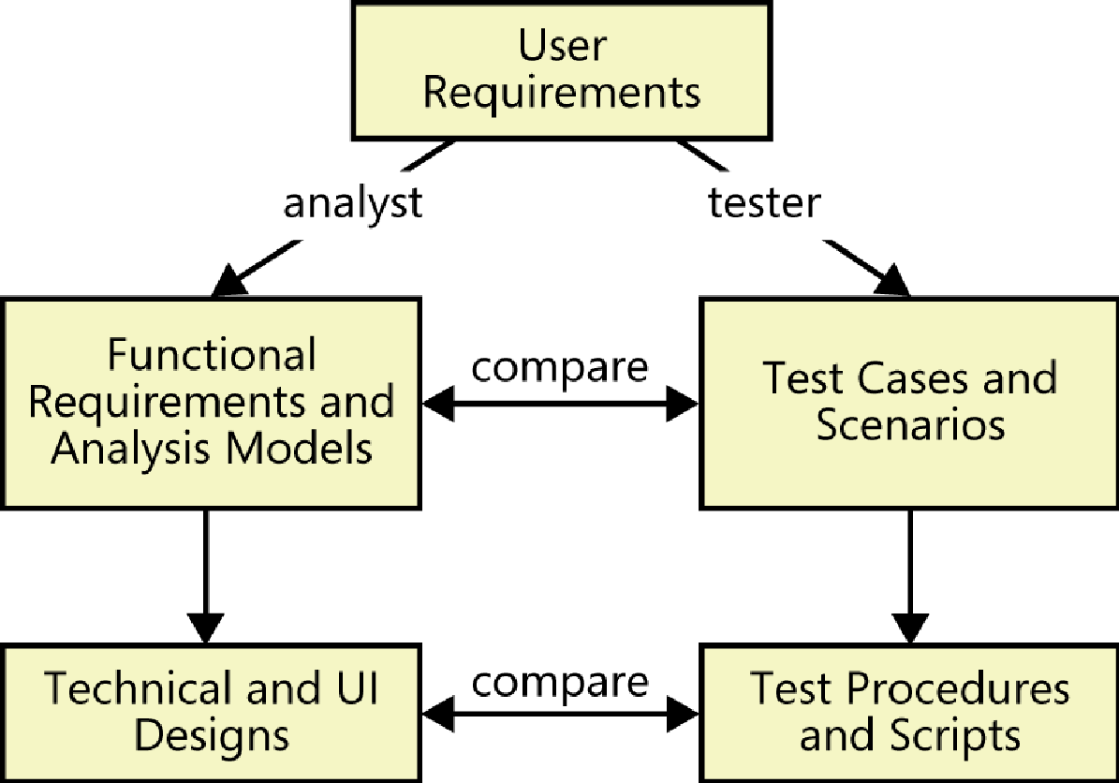
Relationship between Requirements and Tests

Slide 23
Example to demonstrate the relationship between the Requirements and the Tests
Consider the task of requesting a chemical.
1. Business requirement :
Reduce chemical purchasing expenses by 25% in the first year.
2. Use case:
A use case that aligns with this business requirement is “Request a Chemical.” This use case includes a path that permits the user to request a chemical container that’s already available in the chemical stockroom.
The Requester specifies the desired chemical to request by entering its name or chemical ID number or by importing its structure from a chemical drawing tool. The system either offers the Requester a container of the chemical from the chemical stockroom or lets the Requester order one from a vendor

Slide 24
Example to demonstrate the relationship between the Requirements and the Tests
3. Functional requirement
Here’s a bit of functionality derived from this use case:
1. If the stockroom has containers of the chemical being requested, the system shall display a list of the available containers.
2. The user shall either select one of the displayed containers or ask to place an order for a new container from a vendor.

Slide 25
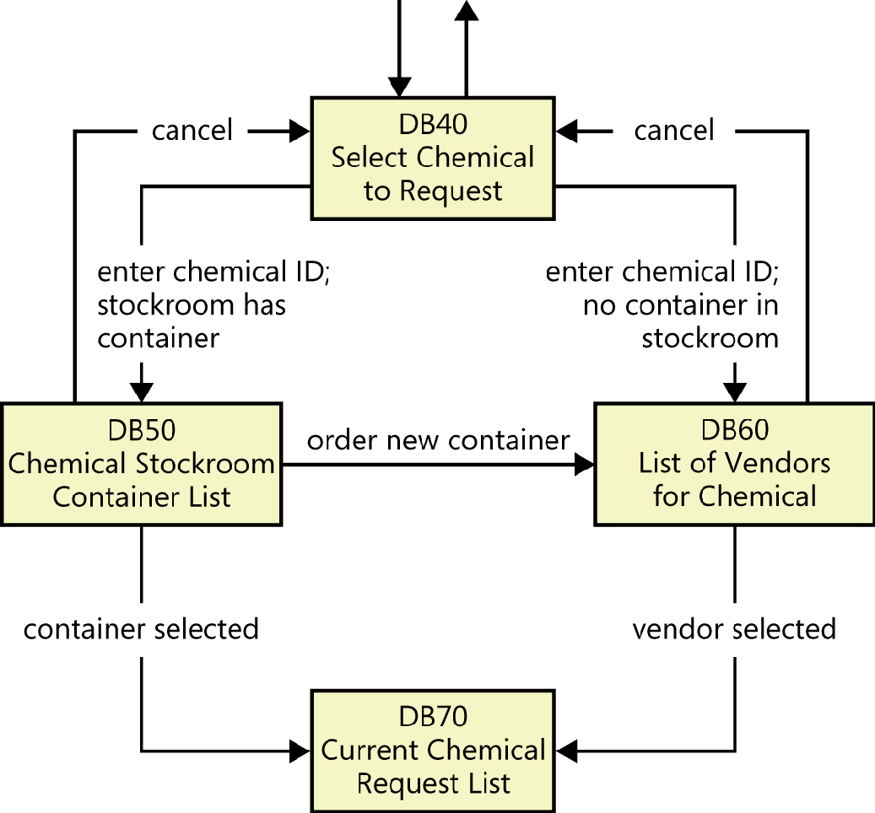
Example to demonstrate the relationship between the Requirements and the Tests
4. Dialog Map

Slide 26
Example to demonstrate the relationship between the Requirements and the Tests
5. Test
Because this use case has several possible execution paths, you can envision multiple tests to address the normal flow, alternative flows, and exceptions.
The following is just one test, based on the flow that shows the user the available containers in the chemical stockroom.
At dialog box DB40, enter a valid chemical ID; the chemical stockroom has two containers of this chemical. Dialog box DB50 appears, showing the two containers. Select the second container. DB50 closes and container 2 is added to the bottom of the Current Chemical Request List in dialog box DB70.

Slide 27
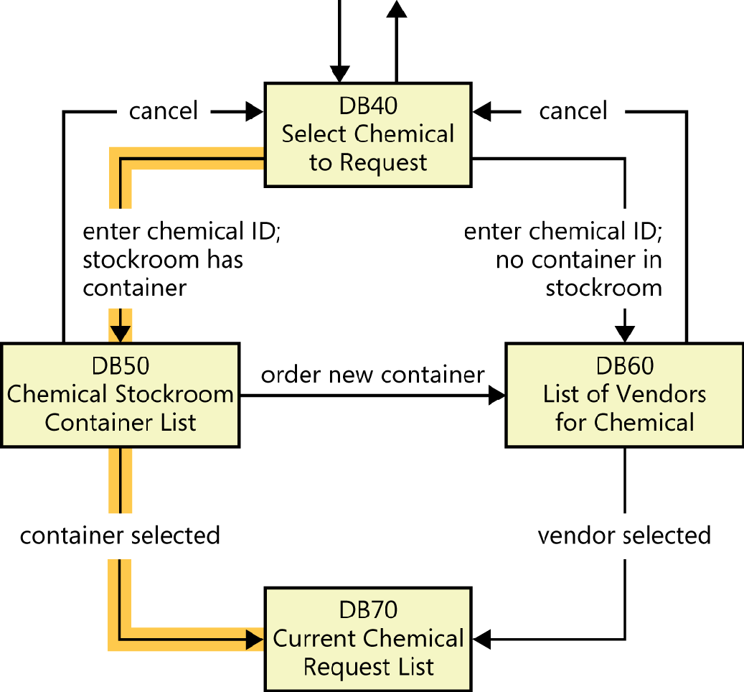

Slide 28
Using Tests to find inconsistent or missing requirements
By tracing the execution path for each test, you can find incorrect or missing requirements, improve the user’s navigation options, and refine the tests.
Consider two scenarios.
Scenario 1
Suppose that after “executing” all the tests in this fashion, the dialog map navigation line labeled “order new container” that goes from DB50 to DB60 in the previous figure hasn’t been highlighted.
There are two possible interpretations:
That navigation is not a permitted system behavior. The BA needs to remove that line from the dialog map. If the SRS contains a requirement that specifies the transition, that requirement must also be removed.
The navigation is legitimate, but the test that demonstrates the behavior is missing.

Slide 29
Using Tests to find inconsistent or missing requirements
Scenario 2
Suppose a tester wrote a test based on his interpretation of the use case that says the user can take some action to move directly from dialog box DB40 to DB70. However, the dialog map in Figure doesn’t contain such a navigation line, so that test can’t be “executed” with the existing requirements set.
Again, there are two possible interpretations.
The navigation from DB40 to DB70 is not a permitted system behavior, so the test is wrong.
The navigation from DB40 to DB70 is legitimate, but the dialog map and perhaps the SRS are missing the requirement that is exercised by the test.

